Slide 1

Ballistic plate of bulletproof jacket.
Name of Student : Roshan Santosh Jadhav
Roll Number : 311066
Gr. Number : 22220205
Department of Electronics and Telecommunication Engineering
Course Name: Intellectual Property Rights
Guide: Dr. Ketki P. Kshirsagar
BRACT’S, Vishwakarma Institute of Information Technology, Pune-48
(An Autonomous Institute affiliated to Savitribai Phule Pune University)
(NBA and NAAC accredited, ISO 9001:2015 certified)

Slide 2
CONTENTS
1.Title(Applicant Details and Publication Details)
2.Subject of the Patent
3.Importance of this patent(Revenue , Marketing Benefits)
4.Novelty
5.Utility/Industrial Application
6.Non-Obviousness/ Inventive Step
7.Valuable tools
8.Conclusion
ROSHAN JADHAV, Department of Electronics and Telecommunication Engineering, VIIT, Pune-48

Slide 3
Title:-
Applicant Details:- JONG OAK KIM , Seoul ( KR )
Inventor:- JONG OAK KIM , Seoul ( KR )
Assignee:- Individual
Application No:- US17/673,787
Filed:- 2022-02-17
Patent No:- US 2022/0333901 A1
Date of Patent :- Oct. 20 , 2022
Ballistic plate of bulletproof jacket.
ROSHAN JADHAV, Department of Electronics and Telecommunication Engineering, VIIT, Pune-48 3

Slide 4
Subject of patent
An objective of the present patent is to provide a ballistic plate of a bulletproof jacket that improves bulletproof performance ,
flexibility , and wearability , the ballistic plate improving the defense ability against a bullet by absorbing and distributing shock energy , effectively protecting a body by reducing deformation due to heat and shock energy , providing improved wearability because there is no quilting , and reducing the manufacturing cost by decreasing the materials .
ROSHAN JADHAV, Department of Electronics and Telecommunication Engineering, VIIT, Pune-48 4

Slide 5
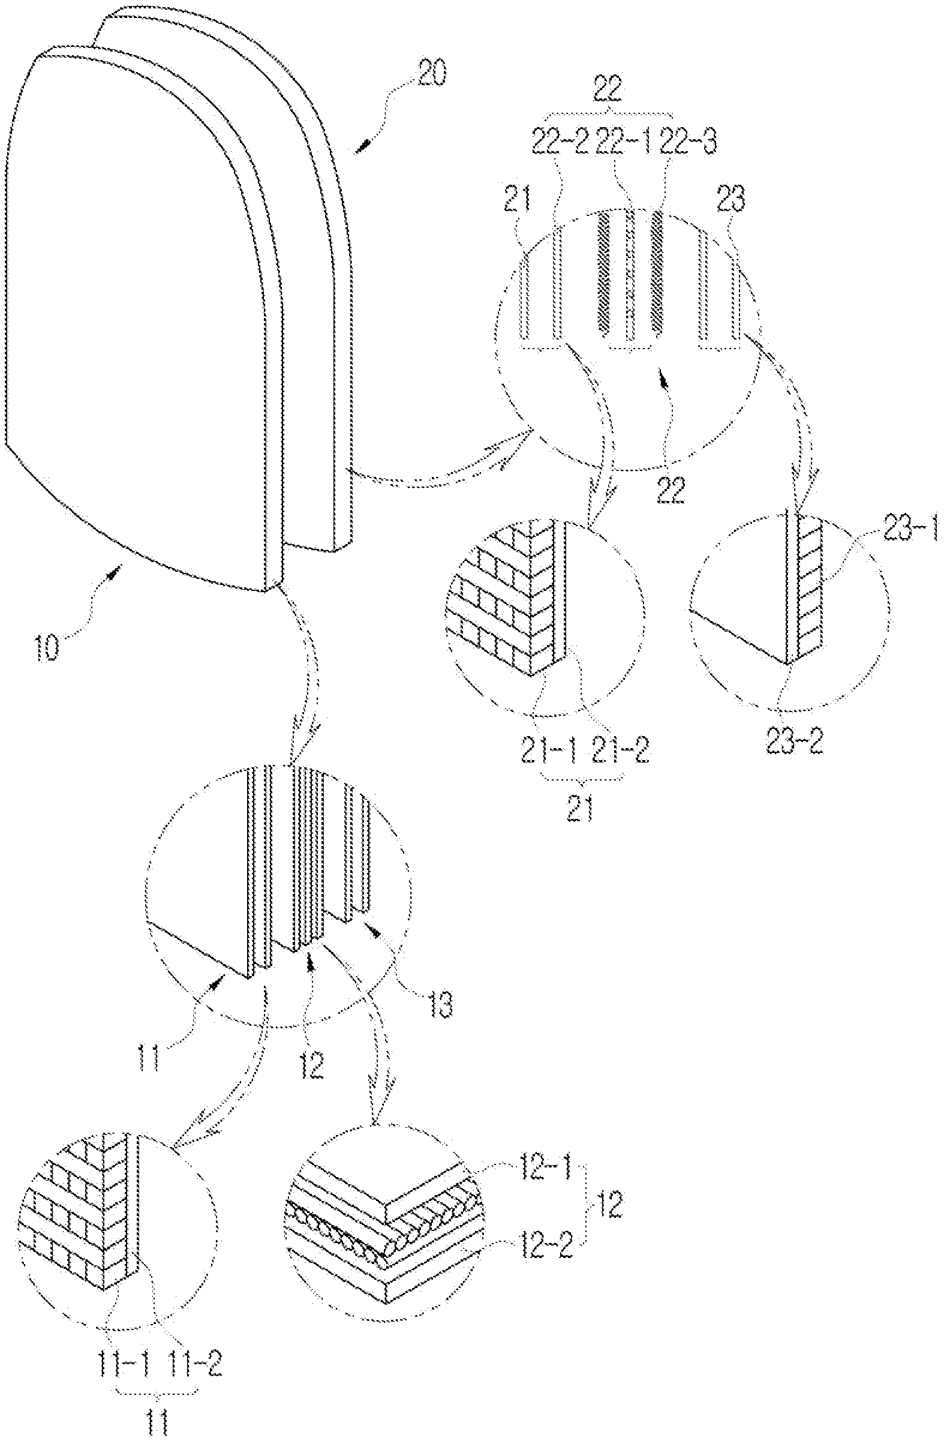
Fig.2 Layer of CT 750 Fabric
ROSHAN JADHAV, Department of Electronics and Telecommunication Engineering, VIIT, Pune-48 5

Slide 6
IMPORTANCE OF THIS PATENT
Manufacturing Cost Reduction: The ballistic plate design aims to reduce manufacturing costs by minimizing the use of materials.
Improved Bulletproof Performance: The plate enhances bulletproof performance while maintaining flexibility and wearability.
No Quilting: Notably, this design does not utilize quilting in the manufacturing process
which also means less cost
ROSHAN JADHAV, Department of Electronics and Telecommunication Engineering, VIIT, Pune-48 6

Slide 7
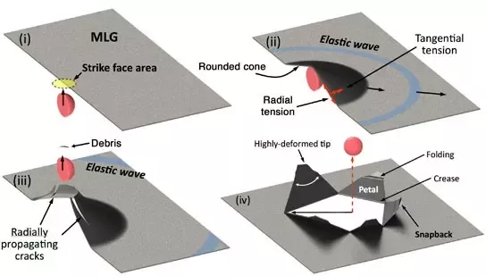
Novelty/Uniqueness
1. Innovative Bulletproof Jacket Plate:
- A ballistic plate for a bulletproof jacket designed to enhance bulletproof performance, flexibility, and wearability.
2. Manufacturing Innovation:
- Manufactured without the use of quilting, reducing complexity and potentially lowering production costs.
3. Dual Defense Principles:
- Primary Defense: Focuses on blocking bullets and effectively absorbing and distributing shock energy without deformation even under high-temperature conditions, including splinter impacts.
- Secondary Defense: Engages after the primary defense, providing protection to the wearer by blocking bullets, absorbing shock energy, and ensuring their safety.
ROSHAN JADHAV, Department of Electronics and Telecommunication Engineering, VIIT, Pune-48 7

Slide 8
Utility/Industrial Application
1. Body Armor and Bulletproof Vests:
- The patented technology can be applied in the manufacturing of body armor and bulletproof vests for military personnel, law enforcement, and security personnel.
2. Ballistic Shields:
- The design principles may be incorporated into ballistic shields used by police forces and special tactical units.
3. Personal Protective Equipment (PPE):
- It can find application in PPE for individuals working in high-risk environments, such as conflict zones, or in roles requiring ballistic protection.
4. Sports and Recreational Activities:
- The technology may be adapted for extreme sports gear, such as protective gear for motocross, paintball, or airsoft activities.
ROSHAN JADHAV, Department of Electronics and Telecommunication Engineering, VIIT, Pune-48 8

Slide 9
Non-Obviousness/Inventive Step
1. Elimination of Quilting:
- The present disclosure eliminates the quilting of front and rear plates, addressing the inflexibility and wearability issues found in the prior patent.
2. Enhanced Flexibility:
- By removing quilting, the ballistic plate achieves improved flexibility, ensuring greater comfort and mobility for the wearer.
3. Improved Shock Absorption:
- The inclusion of a shock-absorbing flex pelt layer between the front and rear plates enhances shock absorption capabilities, contributing to better ballistic performance.
4. Multi-Layered Defense Strategy:
- The ballistic plate employs a dual-defense approach, with primary defense for immediate bullet impact and secondary defense for ongoing protection, enhancing the overall safety of the wearer.
ROSHAN JADHAV, Department of Electronics and Telecommunication Engineering, VIIT, Pune-48 9

Slide 10
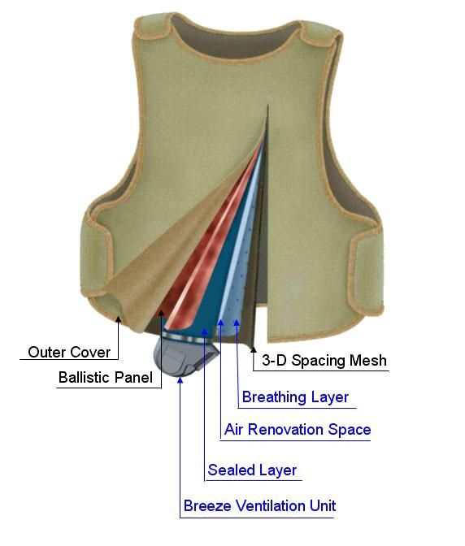
Valuable tool
1. Dual Defense Principles:
- The concept of primary and secondary defense principles is presented, representing a strategic approach to enhancing protection and safety.
2. Sequential Arrangement:
- The method of sequentially arranging specific materials and layers for both primary and secondary defenses is described, outlining a structured approach to achieving better protection.
3. Material Selection:
- The use of high heat-resistant and high-tensile-strength fabrics is emphasized, along with the incorporation of polyurethane-based resin film or PVB film to improve the tensile strength of the heatproof shock-absorbing sheets.
ROSHAN JADHAV, Department of Electronics and Telecommunication Engineering, VIIT, Pune-48 10

Slide 11
claims
1. Ballistic plate for a bulletproof jacket with improved performance, flexibility, and wearability.
2. Consists of a bulletproof distribution pad and a shock-absorbing pad without quilting.
3. Bulletproof distribution pad comprises heatproof shock-absorbing sheet, heatproof distribution sheet, and bulletproof sheet.
4. Shock-absorbing pad consists of first heatproof shock-absorbing sheet, flex pelt, and second heatproof shock-absorbing sheet.
5. Heatproof shock-absorbing sheets on front and rear made of fabric with high heat resistance, plus polyurethane-based resin or PVB film for improved tensile strength and shock absorption.
6. Flex pelt in shock-absorbing pad has aramid reinforcement net and aramid pelts.
7. Trauma pad with first and second heatproof shock-absorbing sheets for shock absorption.
8. Trauma pad placed in front and rear of hard armor to absorb transmitted shock energy.
ROSHAN JADHAV, Department of Electronics and Telecommunication Engineering, VIIT, Pune-48 11

Slide 12
Conclusion
In conclusion, the present disclosure addresses critical challenges in ballistic protection by introducing an innovative ballistic plate for bulletproof jackets. This technology significantly enhances bulletproof performance, flexibility, and wearability while effectively absorbing and distributing shock energy. By reducing deformation due to heat and impact, it provides superior body protection.
This innovative solution represents a significant advancement in ballistic protection technology, catering to diverse applications and industries where safety and cost-efficiency are paramount.
ROSHAN JADHAV, Department of Electronics and Telecommunication Engineering, VIIT, Pune-48 12

Slide 13
Thank You
ROSHAN JADHAV, Department of Electronics and Telecommunication Engineering, VIIT, Pune-48 13

